Slide 1

Theme: Smart Education
AI Guruji
TechTians-AIML

Slide 2

1. The Overview
AI Guruji is a career guidance platform for secondary school students. Leveraging advanced AI-based counseling, aptitude tests, and detailed career paths, the platform will provide personalized insights to help students make informed decisions about their future.
LEARN NOW

Slide 3

2. The Problem
The problem being addressed is the lack of accessible, personalized, and holistic career guidance for secondary-level students. The current approach often lacks individualization and trust, leading to uninformed career choices and potential mismatches between students' abilities and chosen paths.
LEARN NOW

Slide 4

Persona
Background: Sarah is a high school student who is trying to figure out what career path to pursue after graduation. She enjoys a variety of subjects but feels overwhelmed by the multitude of options available. She wants guidance to help her explore her interests, skills, and passions to make an informed decision about her future career.
Name: Sarah
Age: 16
Grade: 10th
LEARN NOW

Slide 5

3.The Solution
Our innovative approach offers students comprehensive guidance and assistance in making informed decisions regarding their career paths.
Comprehensive tests (psychometric, aptitude, hobby & interest-based).
Personalized guidance via AI chatbot.
Expert career counseling
Parental involvement.
Tailored support for informed decisions.
LEARN NOW

Slide 6
Value Proposition Canvas
Pain Killer:
Multidimensional career test
Introvert Friendly Chatbot
Counselling and mentorship
Product and services:
AI powered career counselling platform
Career counselor and domain expert mentorship
Gain Creator:
Interest & Hobbies based tests
Pain:
Lack of clarity on career options
Fear of Expression
Anxiety and uncertainty about future career prospects
Jobs:
Career Recommendation
Provide Mentorship
Gains:
Consider my Interests & Hobbies

Slide 7
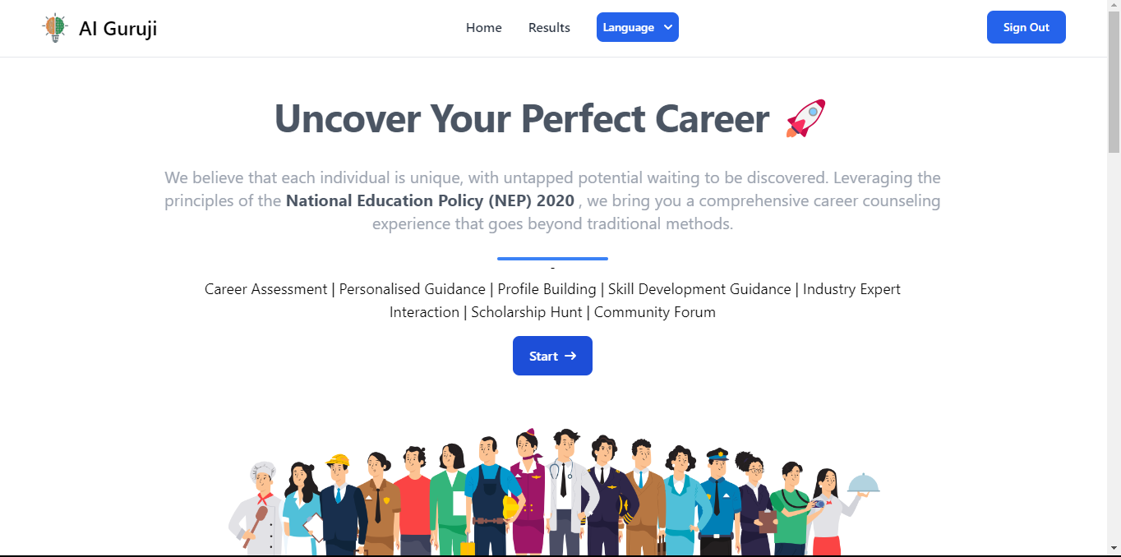
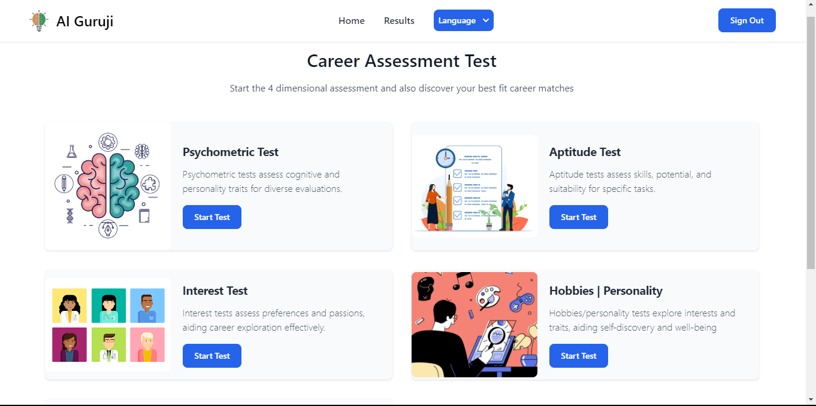
Product Screenshots

Slide 8
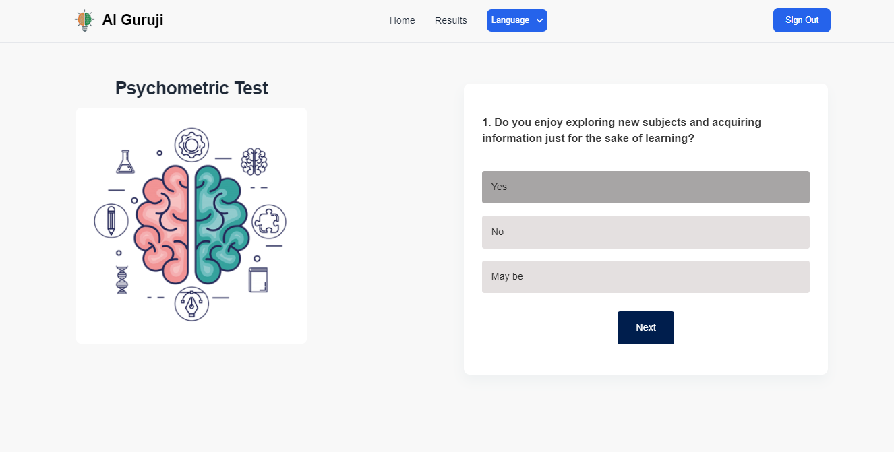
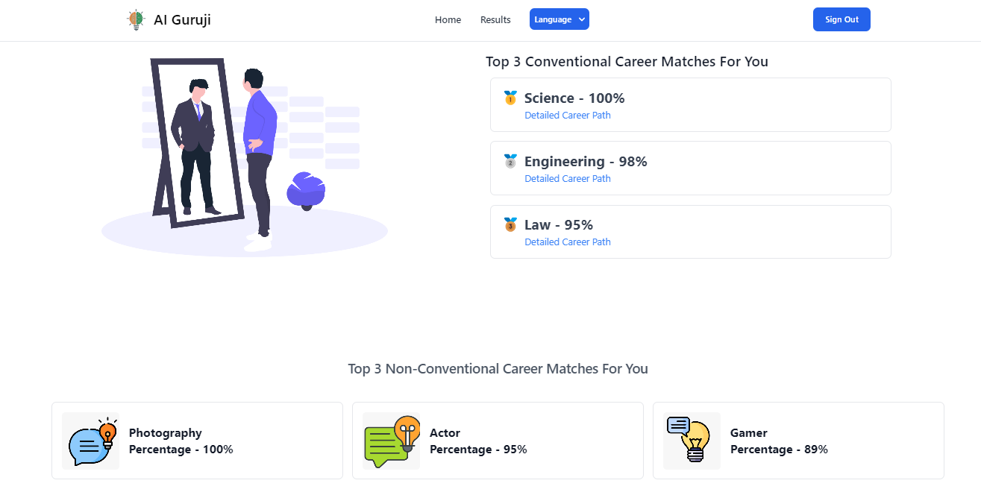

Slide 9
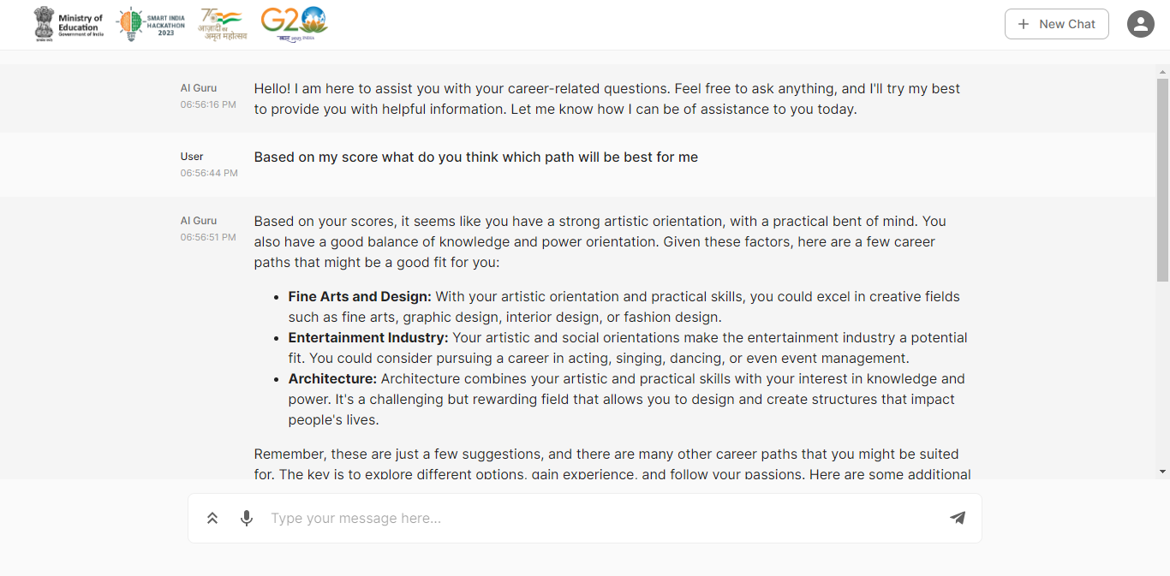
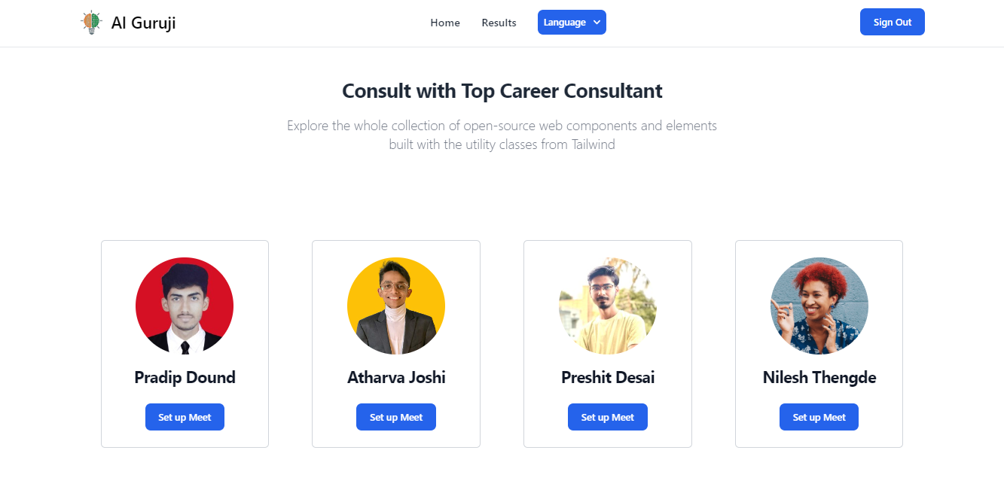

Slide 10

Impact:
Empowered decision-making
Expanded career opportunities
Improved academic performance
Enhanced parental engagement
Long-term success

Slide 11

5. Market & Opportunity
Total Addressable Market (TAM):
India Focus: Between 14 -18 age group, India holds significant potential. Considering factors like internet access and education levels, let's estimate a reachable TAM of 103 million individuals in India.
Student & Parents
Institutions
Counselors
Serviceable Addressable Market (SAM) and SOM:
Targeting secondary school students (ages 14-18) narrows down the SAM. In India, there are roughly 68 million students enrolled in secondary and higher secondary education.
Assuming 30% actively seek career guidance, the SOM could be around 20.4 million students.
Target Market
LEARN NOW
LEARN NOW

Slide 12
6. The Technology/Innovation
Technology Readiness Level (TRL) - 7
Align Your Career Journey with NEP 2020 Principles for an Evolving Education Landscape.
Integrated Emotional Intelligence and Hobbies for Personalized Career Planning.
Foster Informed Career Choices Through Open Communication Between Parents and Students.
AI career counseling chatbot.
Multi-language support.
AI-Powered Mentor Matching for Personalized Career Guidance.

Slide 13
7. Competitive Landscape
Potential Competitors:
Direct Competitors
Online platform like Mindler, careerguide.com etc
Offline Career Counselors
Indirect Competitors
Family and Relatives
Teachers
Friends
Competitive Advantage:
Our product stands out due to:
Advanced AI : Utilizing sophisticated AI for personalized aptitude assessments and career suggestions.
Virtual Counseling Platform: Offering one-on-one virtual sessions with experts for tailored guidance.
Comprehensive Information: Providing detailed career insights, including job descriptions, skills required, educational paths, and salary ranges.
Community Building Features: Connecting students with mentors and peers to foster a supportive community.
Non Conventional Career Options: We are the only platform providing non conventional career options.
LEARN NOW
LEARN NOW

Slide 14
8. LEAN CANVAS
Problem
Lack of Personalized Career Guidance , Unaware about Career paths
Solution
An AI-powered personalized career guidance platform
Unique Value Proposition
Non Conventional Career Test,
Parents Involvement in counselling, NEP based Assessment
Unfair Advantage
Strategic partnership
Customer Segment
Secondary & Higher Secondary Students(age 14 - 18),
Counselors
Existing Alternatives
Online platforms like Mindler, Careerguide.com, Counselors, Teachers/Relatives
High-Level Concept
AI Powered Career Guidance Platform
Early Adopters
Students living in Urban
Areas Familiar with Technologies
Key Metrics
Number of registered users and active platform engagement
Channels
Educational Institutes,
Direct Advertising,
NGOs
Cost Structure
Platform development and maintenance costs, Marketing and advertising expenses
Revenue Stream
Direct Selling to students,
Partnerships with educational institutions for platform access,
Direct Selling to counselors
LEARN NOW

Slide 15

9. Business Model
Source of Revenue:
1. Direct Selling To Students:
One time platform registrations fees and moreover charge as per usage.
2. Partnership with Educational Institutions:
Strategic Partnership for using our platform.
3. Counselor Partnerships:
Establish partnerships with career counselors for implementing our platform into their career counseling programs.

Slide 16
Revenue Projection Schedule
Year | Direct Selling to Students | Partnership with Educational Institutions | Counselor Partnerships | Total Revenue
1 | ₹9,99,000 (1000 students) | ₹18,00,000 (5 institutions) | ₹2,70,000(10 counselors) | ₹30,69,000
2 | ₹14,98,500 (1500 students) | ₹ 28,80,000 (8 institutions) | ₹ 4,05,000 (15 counselors) | ₹47,83,500
3 | ₹19,98,000 (2000 students) | ₹ 43,20,000 (12 institutions) | ₹5,40,000(20 counselors) | ₹68,58,000
4 | ₹24,97,500 (2500 students) | ₹54,00,000 (15 institutions) | ₹6,75,000 (25 counselors) | ₹85,72,500
5 | ₹29,97,000 (3000 students) | ₹ 72,00,000 (20 institutions) | ₹8,10,000 (30 counselors) | ₹1,10,07,000

Slide 17

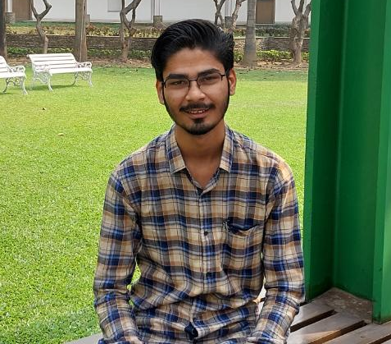

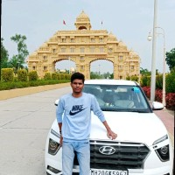
10. The Team
Atharva Joshi
Preshit Desai
Pradip Dound
Nilesh Thengde
Team Leader
Web Developer,
Team Management
Team Member
AIML Engineer
Team Member
Web Developer
Team Member
Marketing & Distribution
LEARN NOW

Slide 18
Thankyou

